Slide 1
TEMPLE DARSHAN TICKET BOOKING
Project Review
Batch number: 46
Under the guidance of : T.SRIKANYA Y.REVATHI
Presented by :
POLIMERU SAI KIRAN-22MH1A0552
I SIVA RAJANNA PADALA-22MH1A0520 THUSTI NIKHIL-22MH1A0574 SANAPATHI RAKESH-22MH1A0561
PEDHAPUDI SHAKTI VAMSI-22MH1A0547
July 2025

Slide 2
CONTENTS
❖ABSTRACT
❖INTRODUCTIION
❖PROBLEM IDENTIFICATION
❖SYSTEM REQUIREMENTS
❖ARCHITECTURE
❖INPUT & OUTPUT IMAGES
❖ADVANTAGES
❖CONCLUSION

Slide 3
ABSTRACT
The Temple Darshan Ticket Booking System is a user-friendly web application built using the Django framework. It enables devotees to book darshan (temple visit) slots online, helping reduce long queues and ensure smooth crowd management. The system supports features like user registration, secure login, viewing available time slots, real-time slot tracking, and optional payment integration. Administrators can manage slot availability, monitor bookings, and generate reports to control temple entry and scheduling efficiently. With Django’s built-in authentication and database handling, the system ensures secure data management and a reliable user experience. Designed especially for the post-pandemic era, this solution supports contactless booking and promotes digital adoption in religious spaces. It offers a scalable and efficient model for temples seeking to modernize their operations while maintaining health and safety protocols.

Slide 4
INTRODUCTION
In recent years, digital technologies have transformed how religious services are delivered, especially in temples that attract large numbers of devotees. The Temple Darshan Ticket Booking System, built using the Django web framework, provides a structured and contactless way for devotees to book darshan (temple visit) slots online. This reduces long queues, prevents overcrowding, and creates a smoother, safer experience during regular days and festivals. The system has two main users: devotees, who can register and book available time slots, and administrators, who manage slot availability, monitor bookings, and access attendance reports. Built with Django’s secure authentication, session handling, and a responsive frontend, the application ensures a seamless user experience. The use of a relational database (SQLite or PostgreSQL) supports efficient data management. Especially relevant in a post-pandemic world, this system not only promotes digital adoption in temples but also lays the groundwork for future features like donations, QR code entry, and VIP access.

Slide 5
PROBLEM IDENTIFICATION
Traditional temple visits involve long queues and overcrowding, especially during festivals.
Manual ticketing systems lead to inefficiency and mismanagement.
Lack of real-time slot availability causes uncertainty for devotees.
No proper system for crowd control or visitor scheduling.
Safety and hygiene issues arise in post-pandemic conditions due to unmanaged gatherings.
Elderly and distant devotees face difficulty planning visits without an online option.
Temple staff lack tools to track attendance, manage bookings, or analyze data.
Absence of a digital system reduces operational transparency and convenience

Slide 6
SYSTEM REQUIREMENTS
Component Specification (Simplified)
Operating System: Windows 10/11, Ubuntu 20.04+, or macOS
Backend: Django 4.x (Python Web Framework)
Language: Python 3.10 or higher
Database: SQLite (development) / PostgreSQL or MySQL (deployment)
Frontend: HTML5, CSS3, Bootstrap (for styling)
Web Server: Django’s built-in server (testing) / Gunicorn + Nginx (deployment)
Browser Support: Chrome, Firefox, Edge, Safari (latest versions)
Package Manager: pip (for installing Python packages)
Tools Used: Django Admin, Django ORM, Virtualenv
Code Editor: VS Code, PyCharm, Sublime Text, etc.

Slide 7
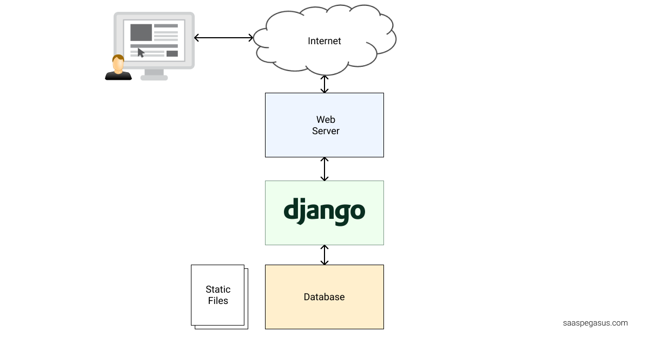
ARCHITECTURE
Frontend :
The user interface is designed using HTML, CSS, and JavaScript.
Backend :
Django handles application logic, user authentication, and database interactions.
Database :
A relational database stores user information and booking details.

Slide 8
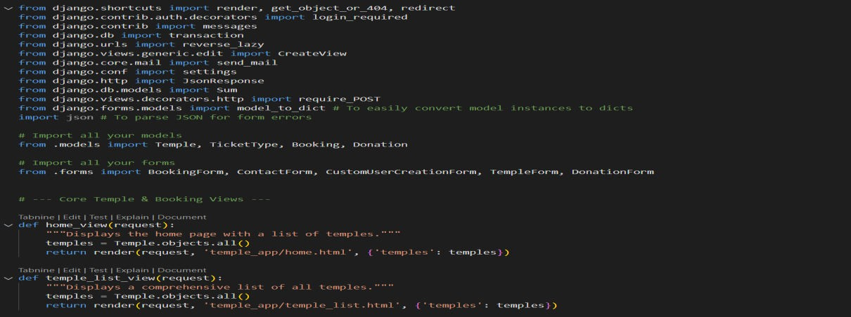
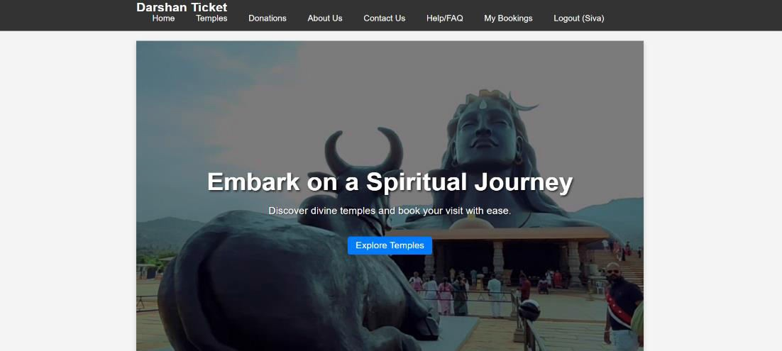
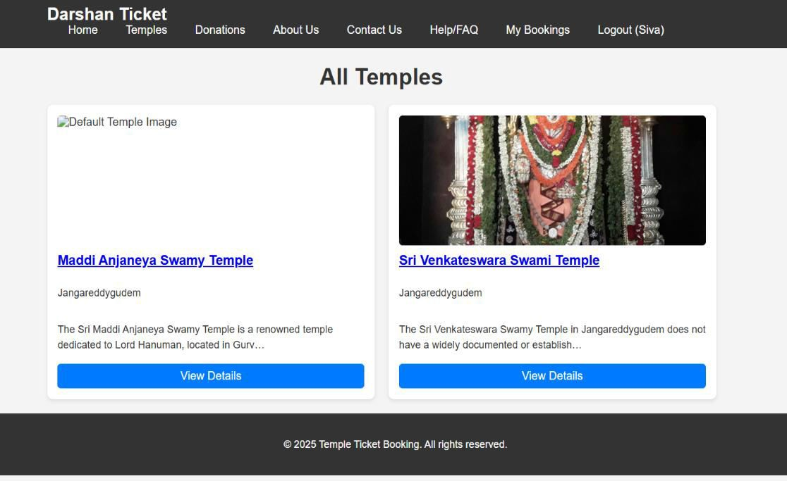
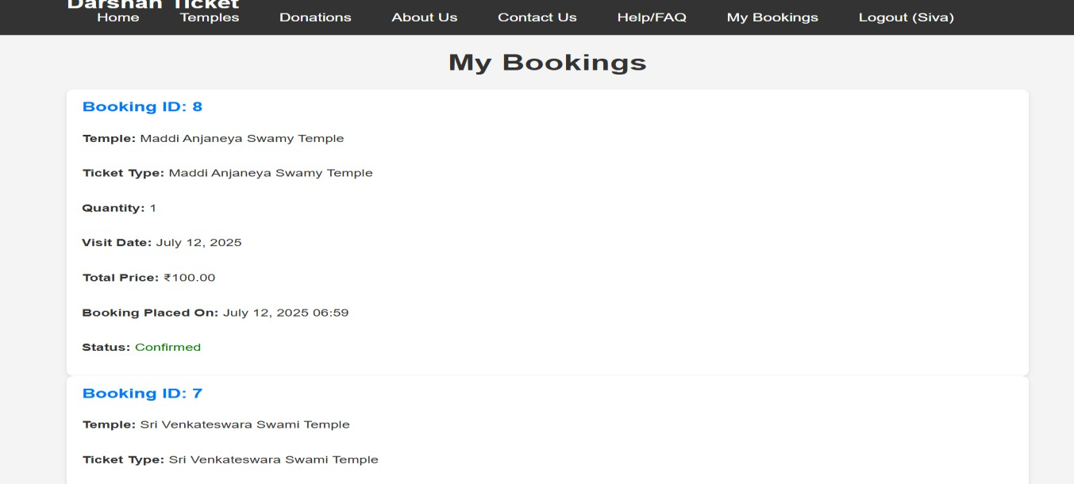
INPUT & OUTPUT IMAGES

Slide 9
ADVANTAGES
User-Friendly & Convenient
Devotees can book darshan tickets online anytime, avoid long queues, and choose their preferred date and time slots.
Effective Crowd Management
Time-slot-based bookings reduce overcrowding, improve visitor flow, and support safety measures like social distancing.
Powerful Admin Control
Admins can manage bookings, slots, and attendance through a dashboard with automated ticketing and data tracking.
Secure & Scalable System
Built on Django with strong authentication, the system supports large temples and ensures secure, reliable data handling.
Ready for Future Needs
Easily expandable with features like donations, payment gateways, alerts, and QR-code check-ins for a safer, smarter experience.

Slide 10
CONCLUSION
This project successfully developed a user-friendly Temple Ticket Booking System using Django. It streamlines temple visit planning by allowing users to register, log in, book tickets, view their bookings, and make donations online. The admin panel enables temple authorities to manage bookings, ticket types, and temple details efficiently. By reducing long queues and manual work, the system offers a centralized platform that is secure, scalable, and easy to use. It shows how technology can enhance religious services and improve user experience. Future improvements could include online payments, notifications, and mobile app support—making temple visits even more accessible and organized.

